Slide 1
Faasos
SkiLLs Used- STRUCTURED QUERY LangUage (ADVANCED CONCEPTS)
ConCepTs Used Joins
Subquery
CTe window
FUnCTions
daTeTime fUnCTions STRing function

Slide 2




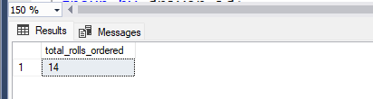
How many RoLLs were Ordered

Slide 3

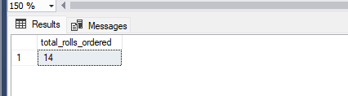
How many CUsTomeRs oRdeRed RoLLs

Slide 4
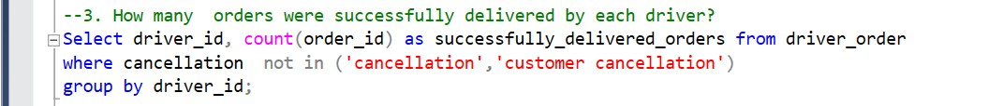
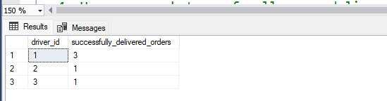
How many ORdeRs weRe sUCCessfULLy deLiveRed by eaCh dRiveR

Slide 5


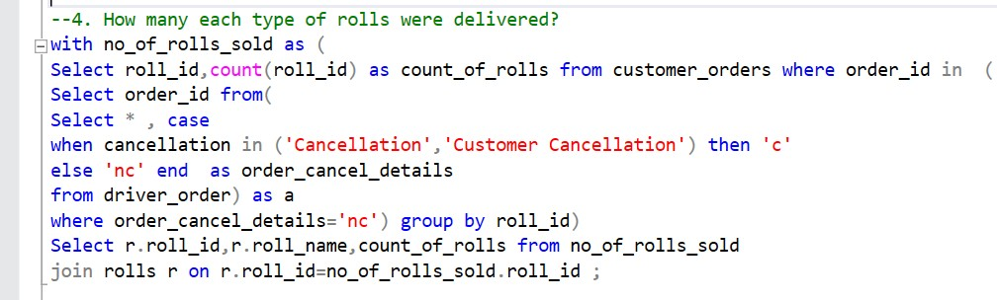
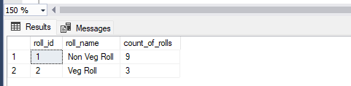
How many each type of roll were delivered

Slide 6
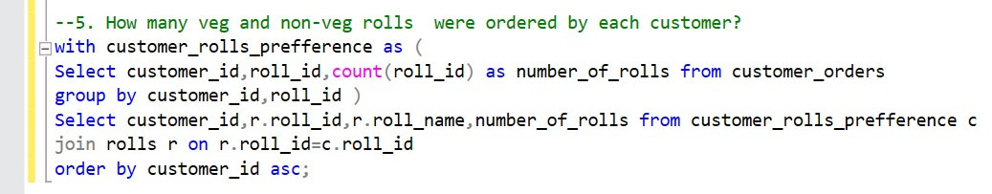
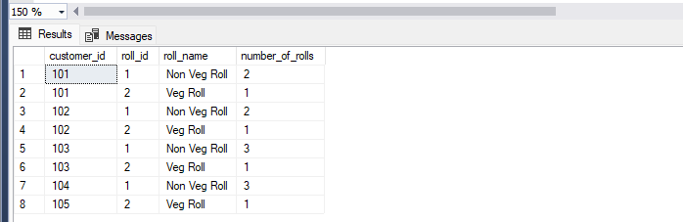
How many veg and non-veg Rolls weRe oRdeRed by eaCh CUsTomeR

Slide 7
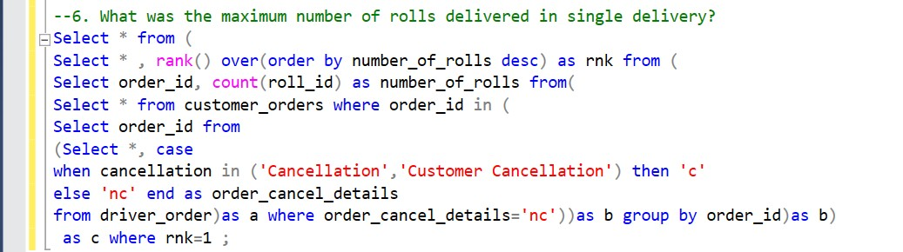
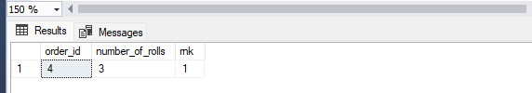
WhaT was The maximUm nUmbeR of Rolls oRdeRed in single deliveRy

Slide 8
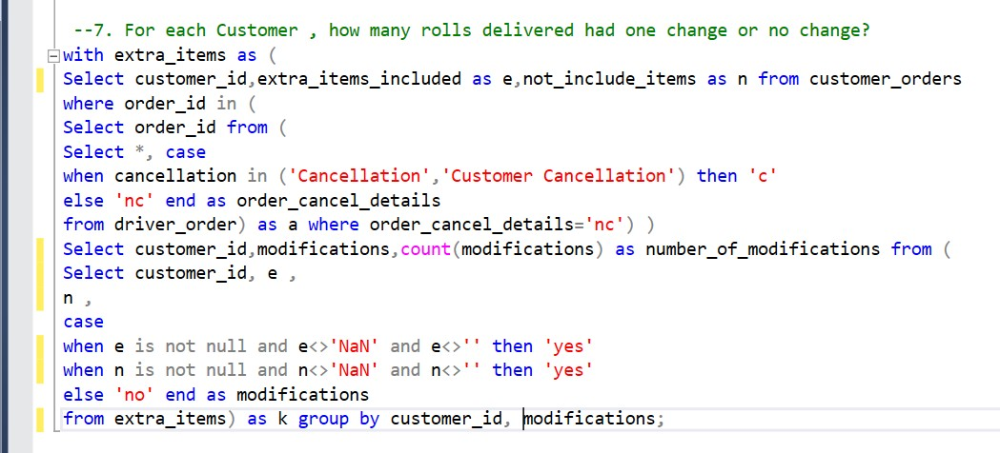
foR eaCh CUsTomeR, how many deLiveRed had Change oR no Change
soLUTion neXT

Slide 9
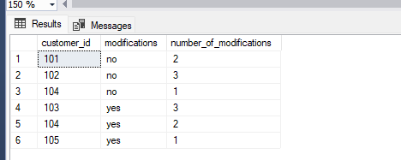
foR eaCh CUsTomeR, how many deLiveRed had Change oR no Change

Slide 10
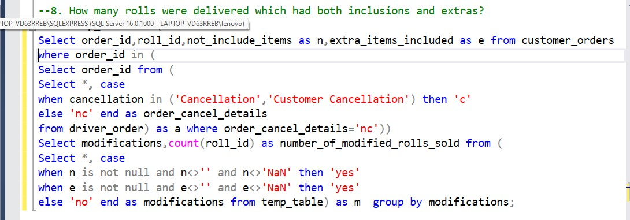
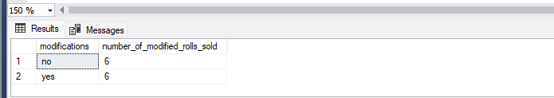
how many RoLLs weRe deLiveRed whiCh had boTh inCLUsions and eXTRas

Slide 11
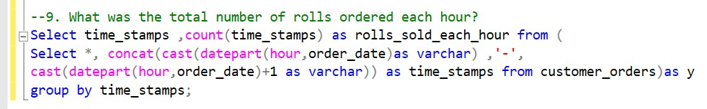
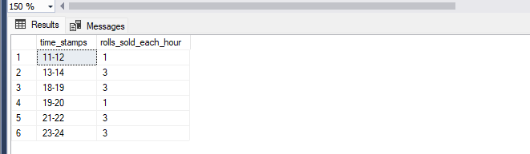
whaT was The ToTaL nUmbeR of RoLLs oRdeRed eaCh hoUR

Slide 12
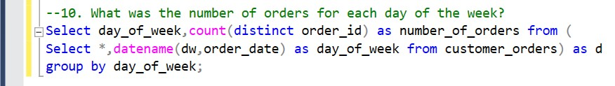
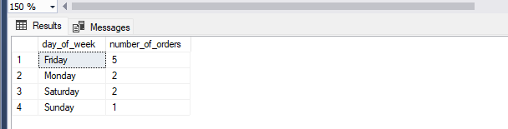
whaT was The nUmbeR of oRdeRs foR eaCh day of The week

Slide 13
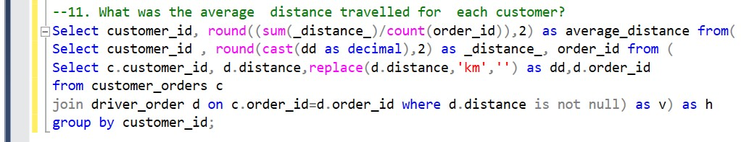
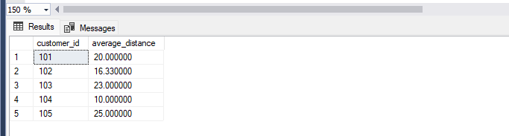
whaT was The aveRage disTanCe TRaveLLed foR eaCh CUsTomeR

Slide 14
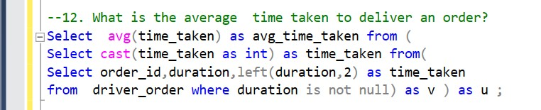

whaT was The aveRage Time Taken To deLiveR an oRdeR

Slide 15
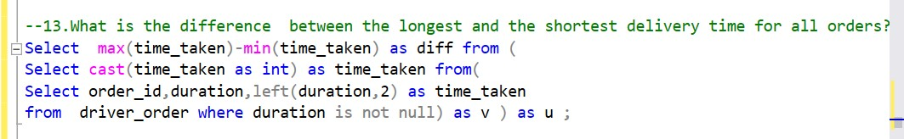

what is the difference between the longest and the shortest delivery time for all orders

Slide 16


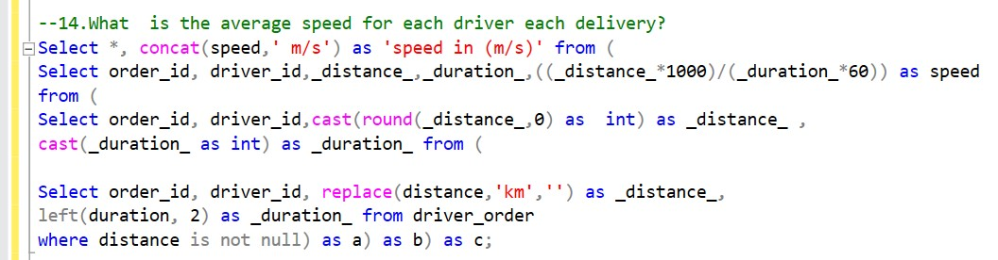
whaT is The speed of each driver for each deLivery
soLUTion neXT

Slide 17


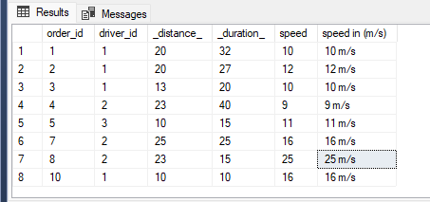
whaT is The speed of each driver for each deLivery

Slide 18
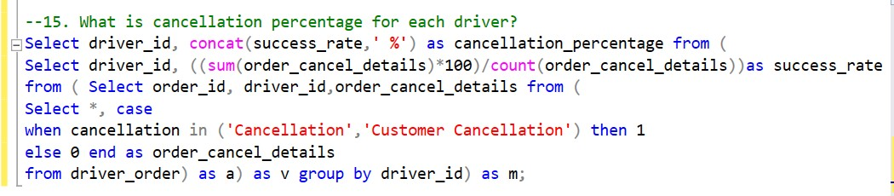
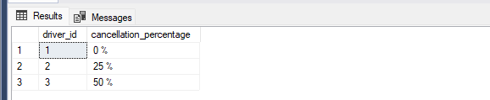
whaT is canceLLaTion percenTage for each driver

Slide 19

Thank you Thank you

